Slide 1

The little things that run the world... -E.O. Wilson
Bolívar Aponte Rolón
PhD candidate
Tulane University
FCAT-Ecuador
July 2023

Slide 2
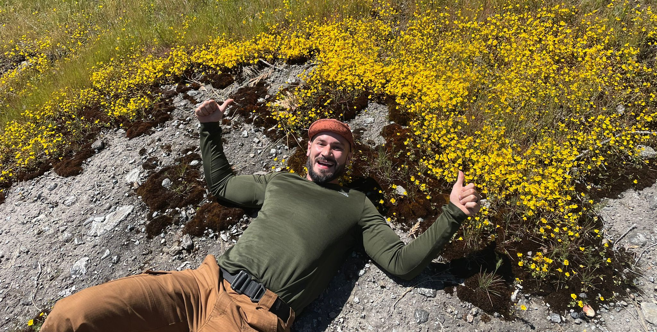
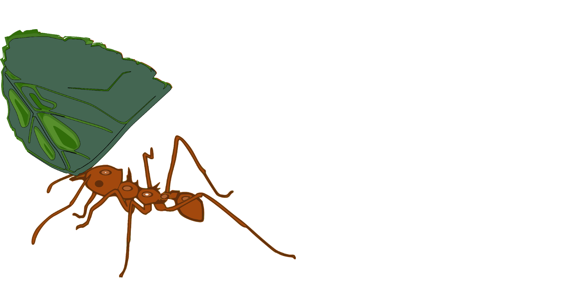
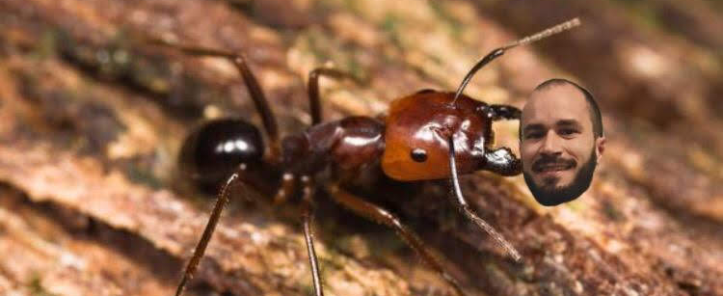
Who’s Boli?
Bolívar Aponte Rolón
baponterolon@tulane.edu
5th year Ph.D. student in EBIO
M.Sc. in Conservation Ecology at the University of Michigan
B.A. in Political Science, University of Puerto Rico, Río Piedras

Slide 3
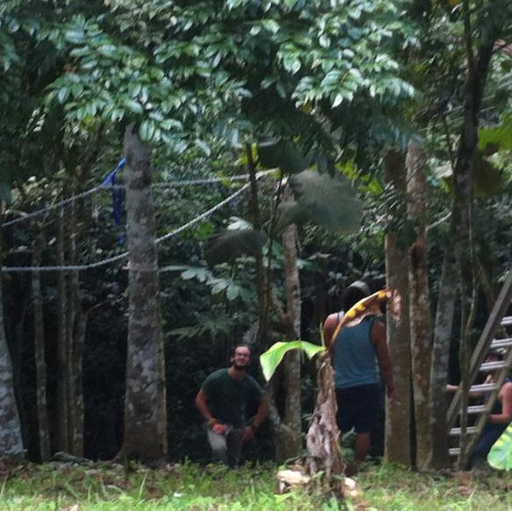
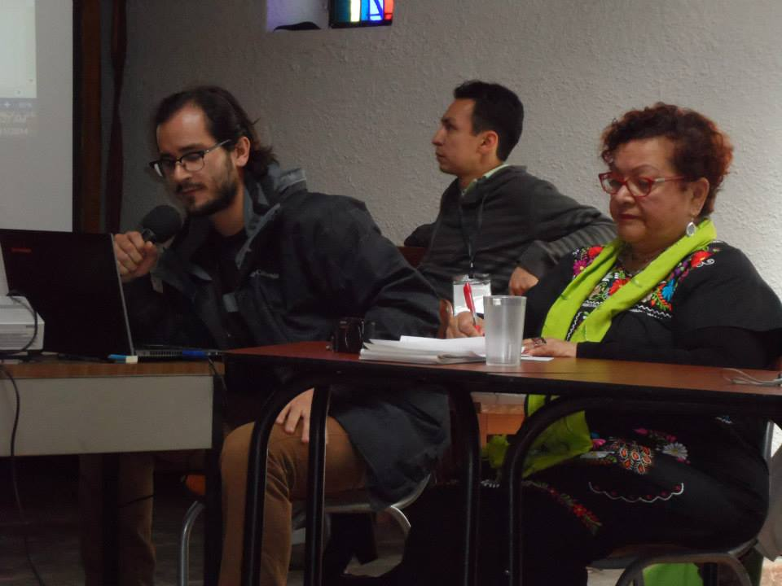
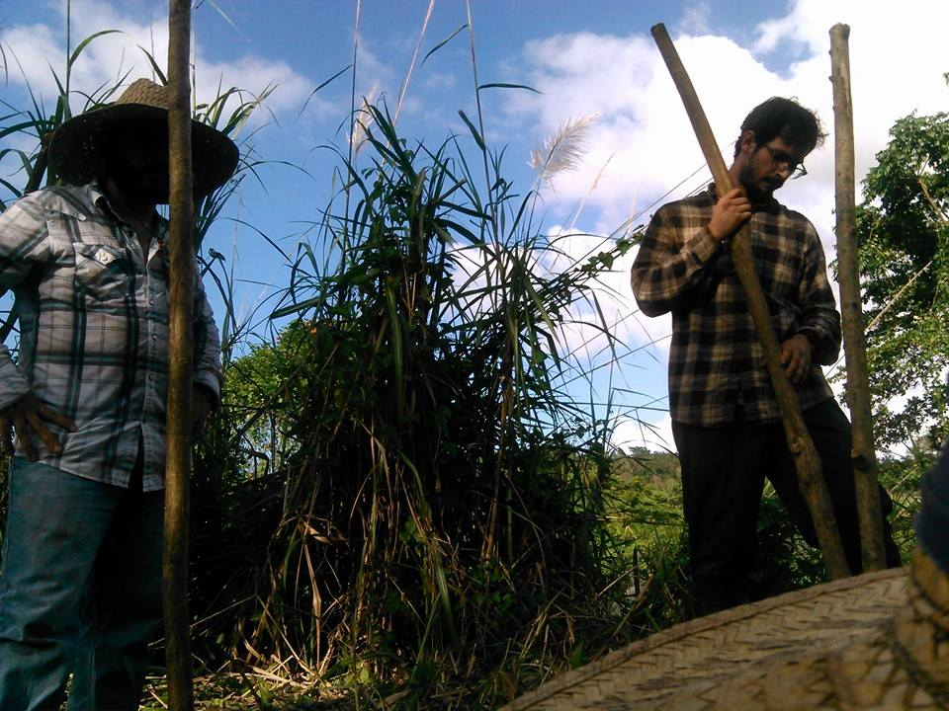
Changing paths
Political Science: the analysis of political activity and behavior (Oxford).
Ecology: a branch of science concerned with the interrelationship of organisms and their environments (Mirriam-Webster)

Slide 4
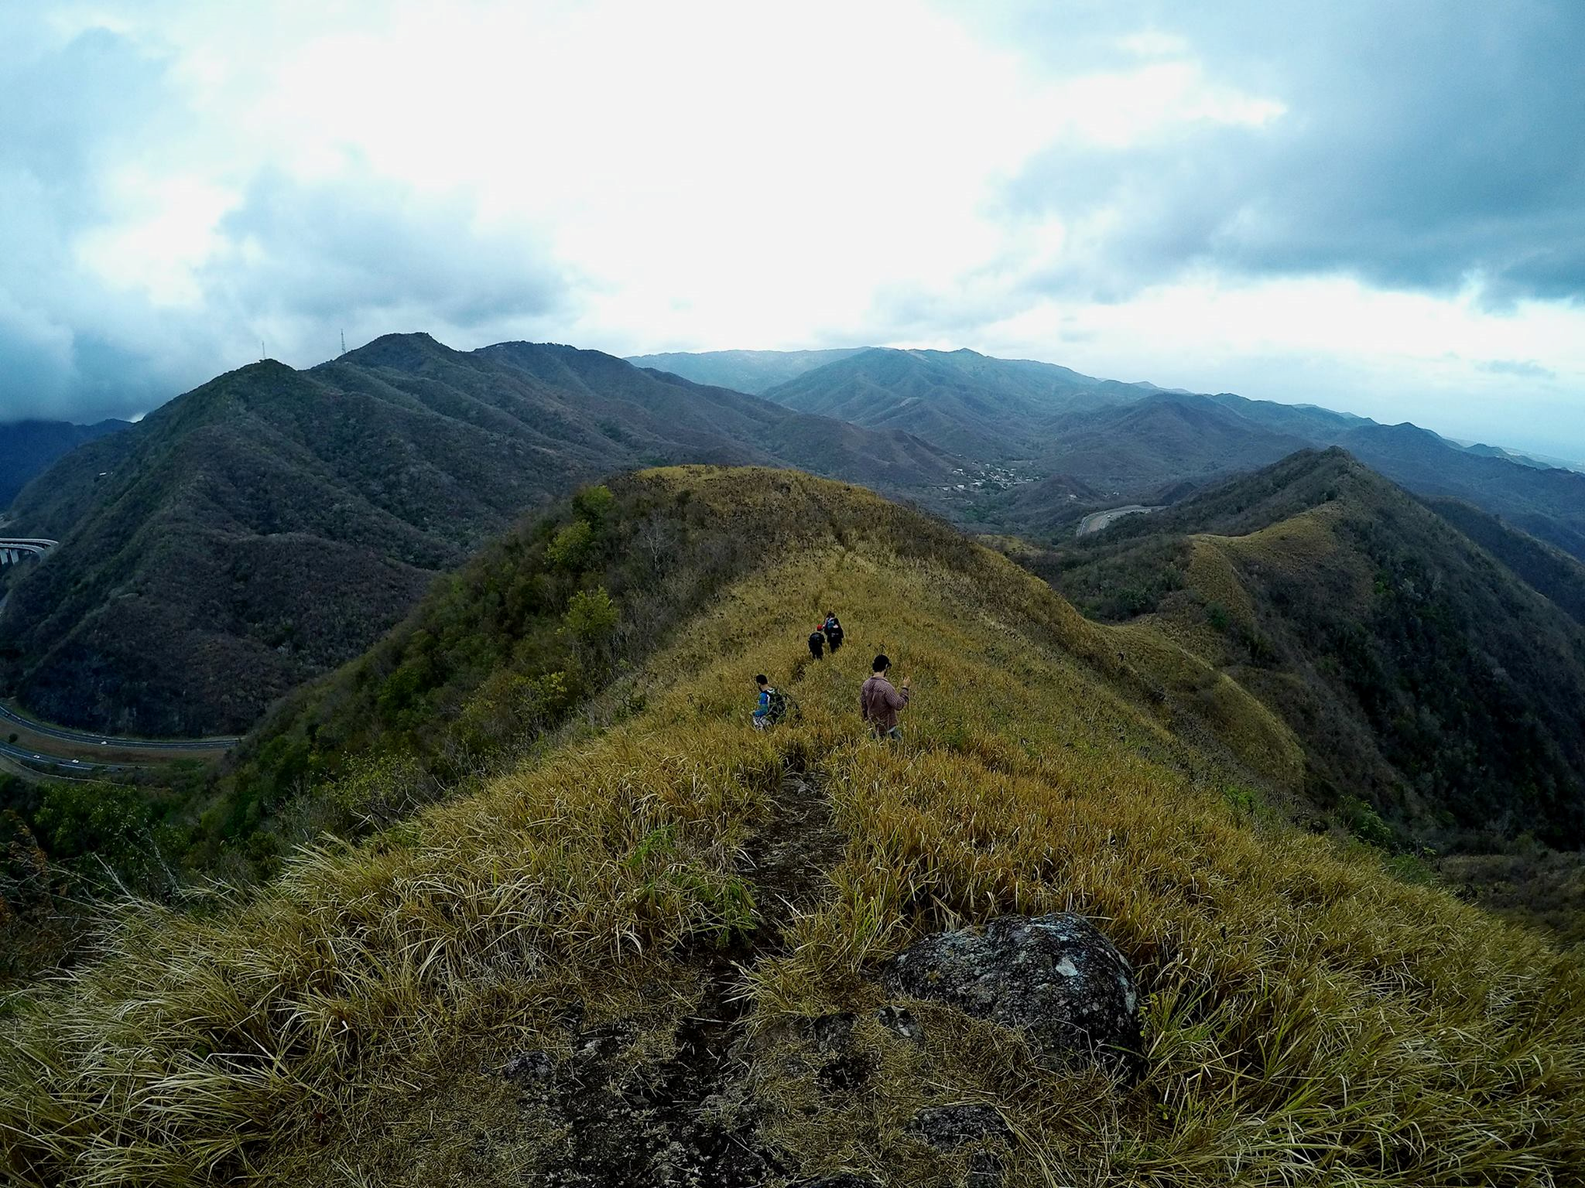
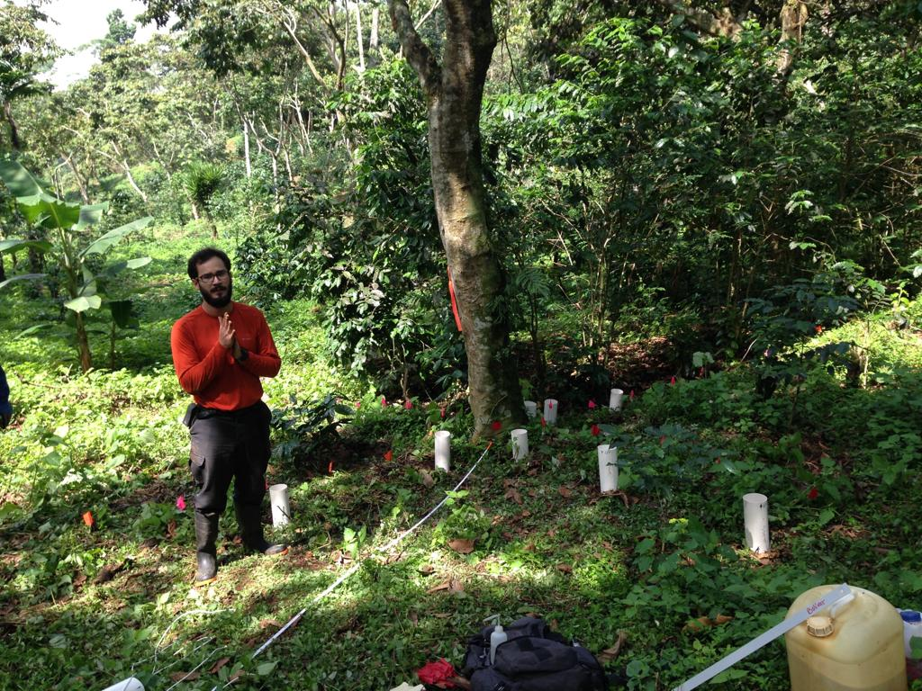
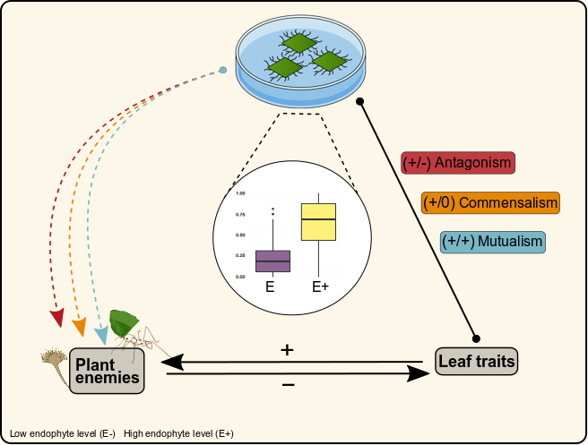
Fungi and ants to ask questions

Slide 5
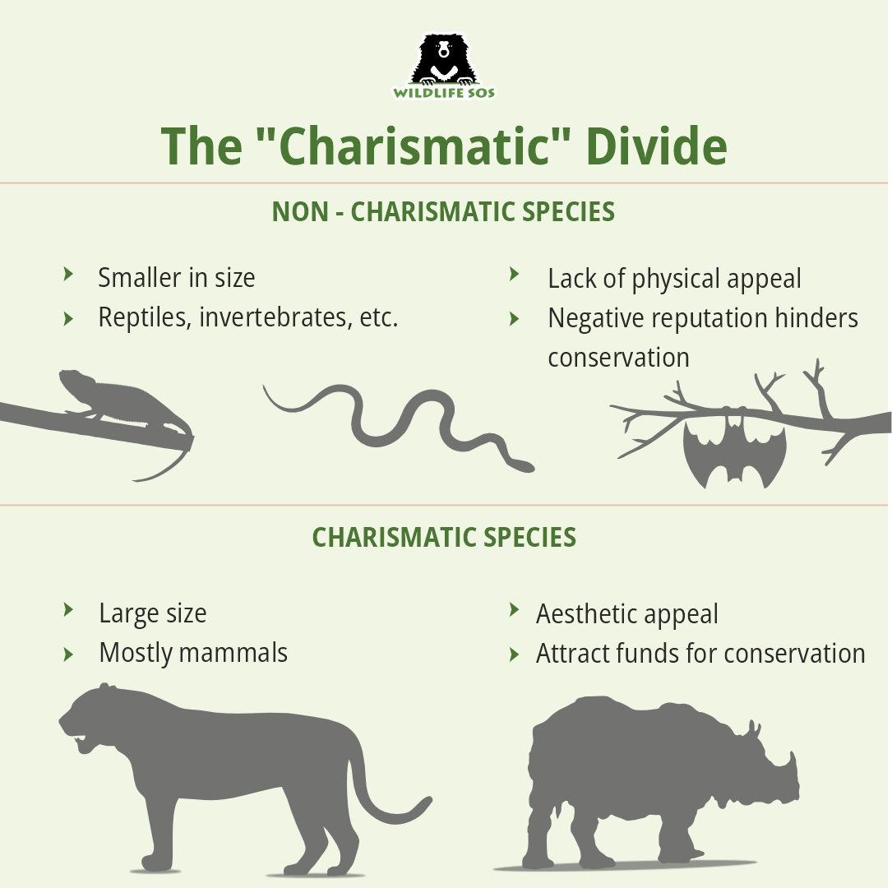

Slide 6
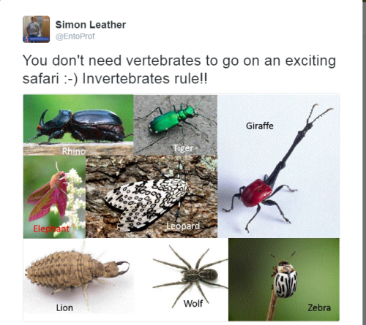

Slide 7
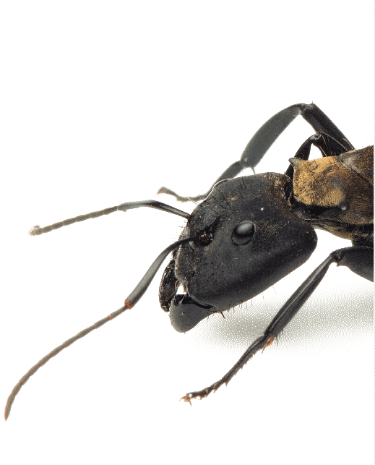
What do we now about ants?
Pros
Cons
Eat carrion
Can pollinate
Eat my food (or my cat’s)
Can sting
Can be pests to crops
Dig up my plants

Slide 8
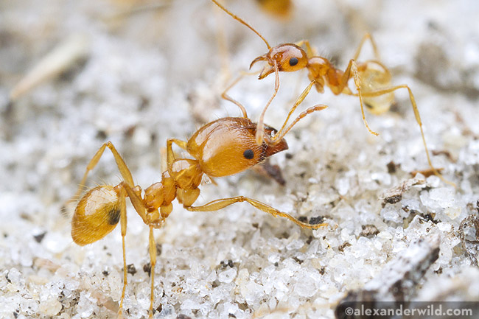
Big questions
Where do you see ants?
How can we study ants? Why study ants?
Why do they run the world?

Slide 9
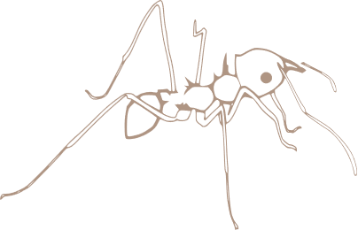

How do we know it’s an ant?
Ideas?
Order?
Family?

Slide 10
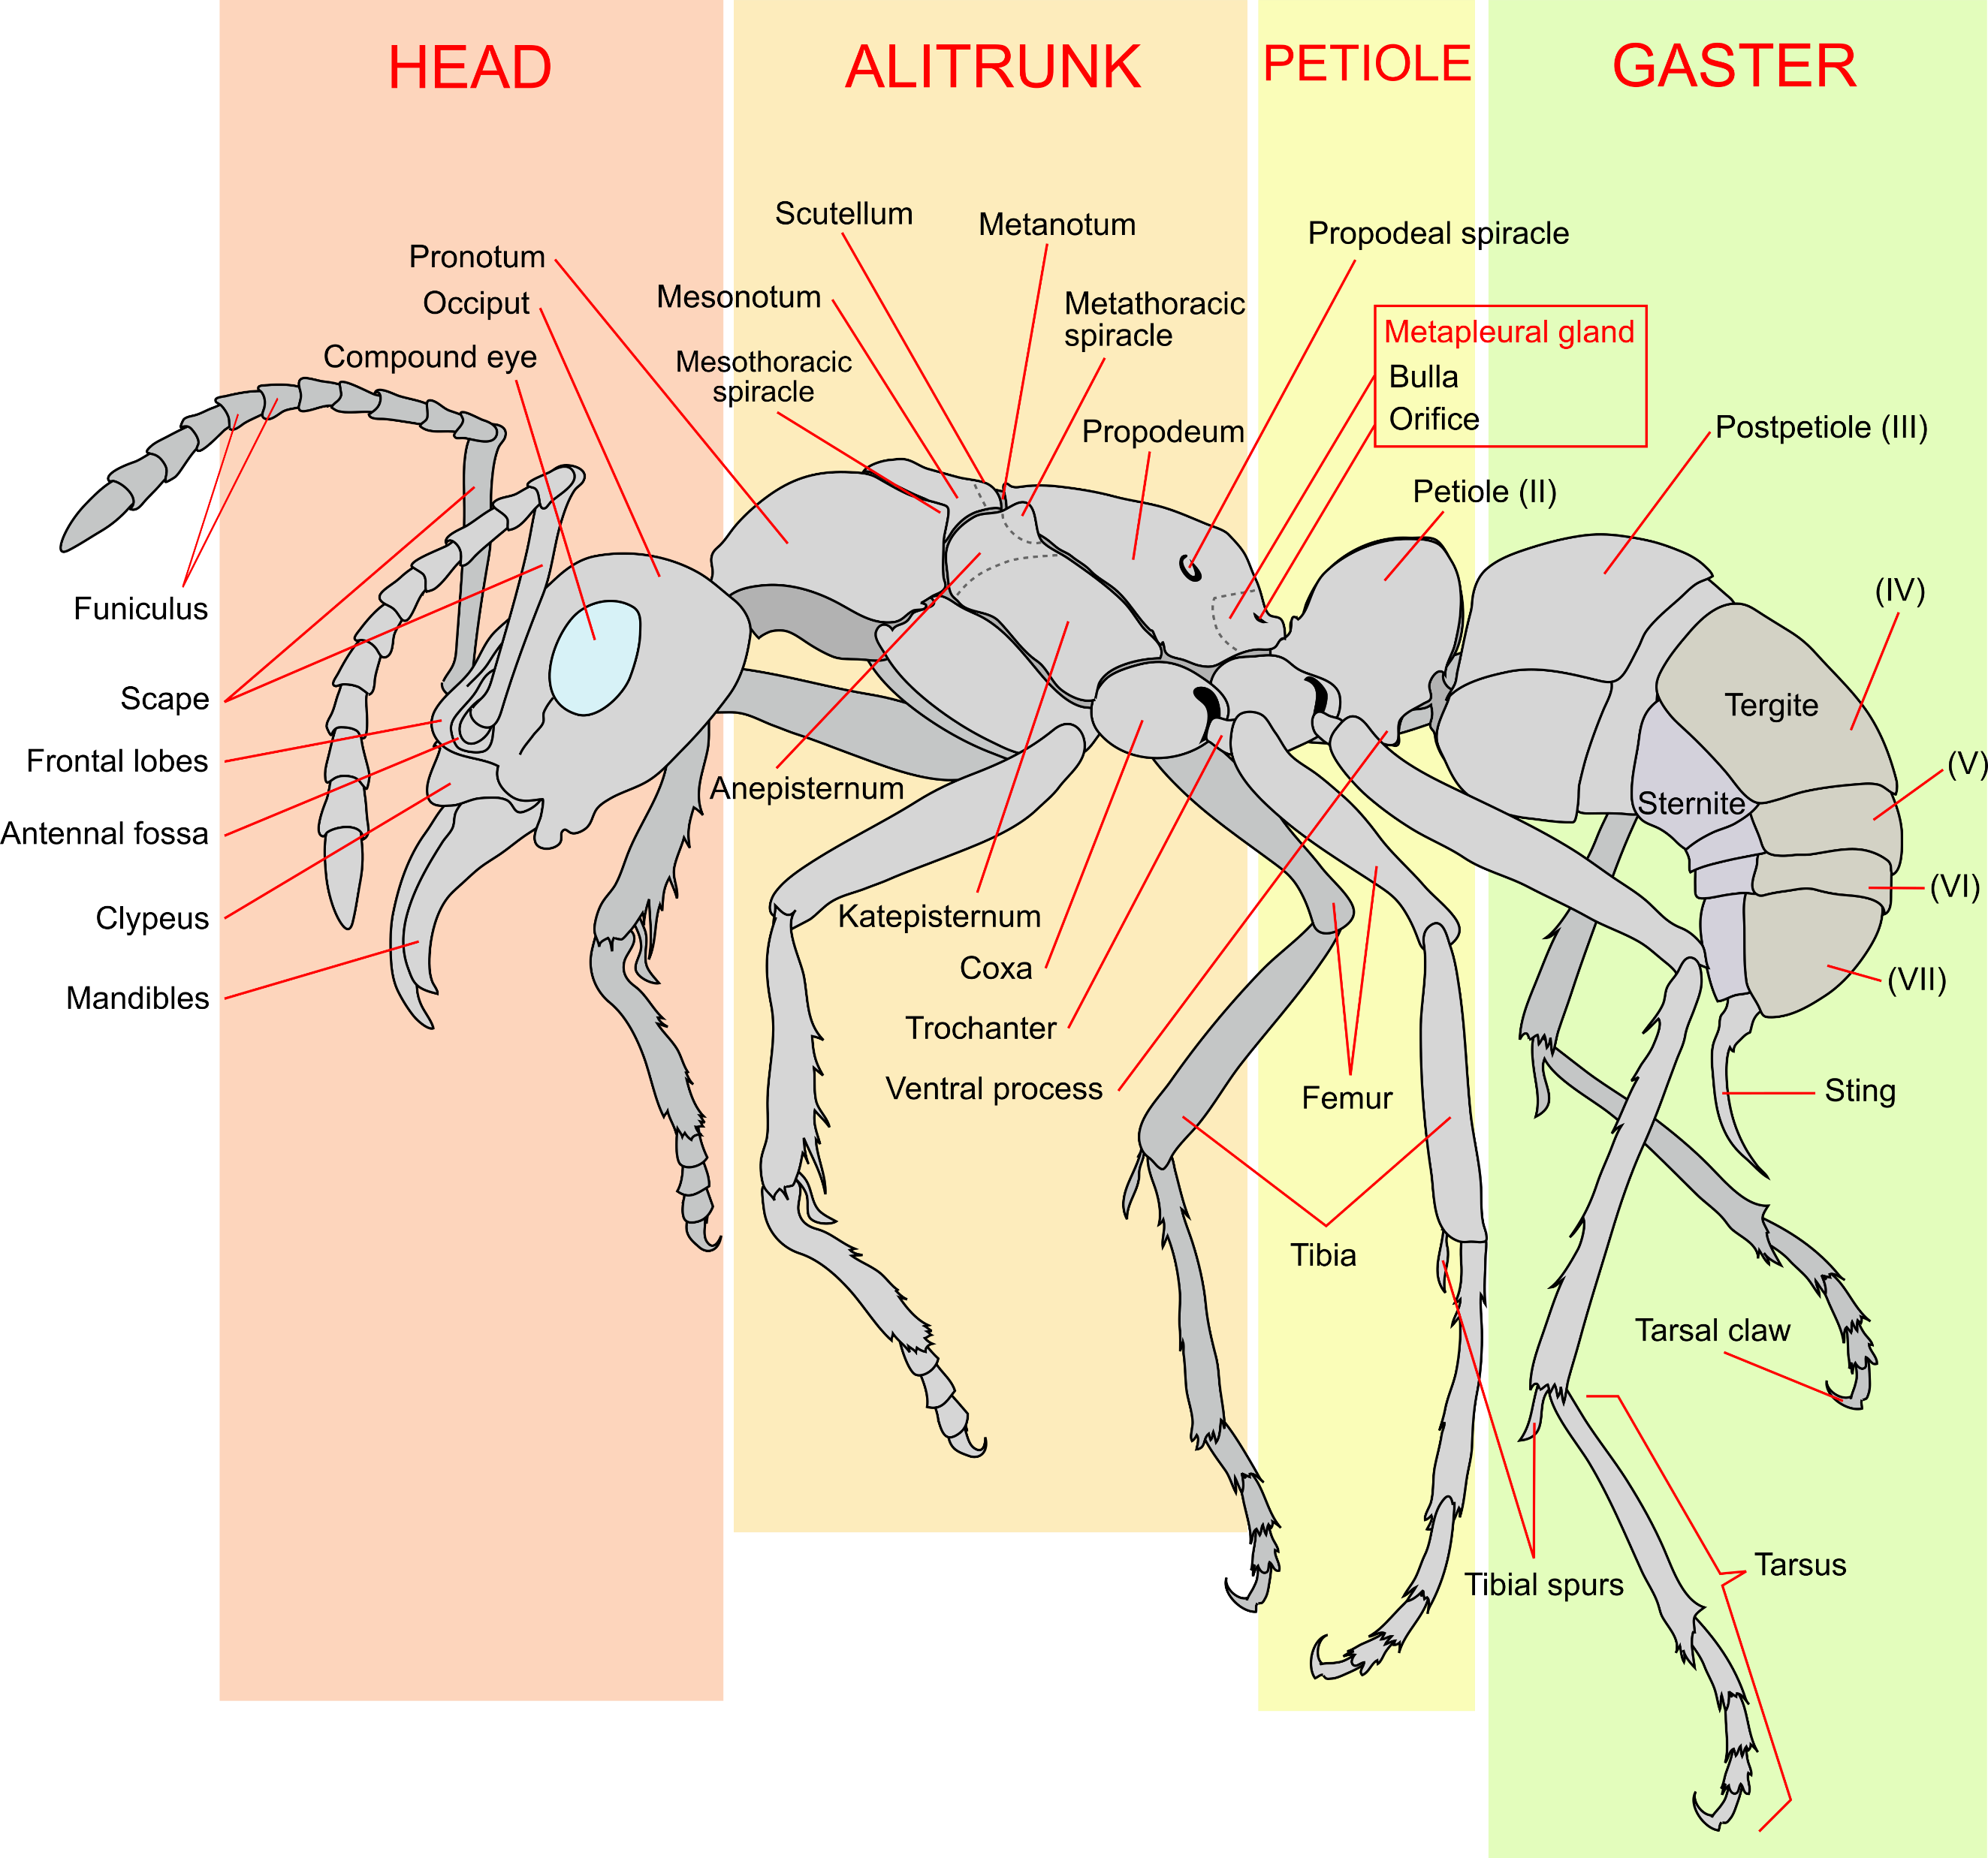
How do we know it’s an ant?
Ideas
They look ant like!
What does that look like?

Slide 11
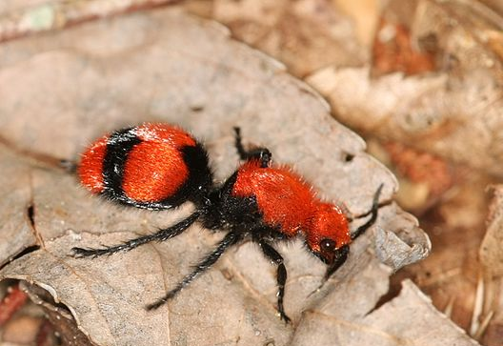
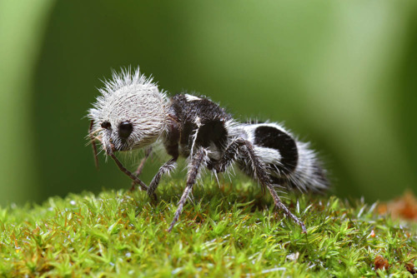
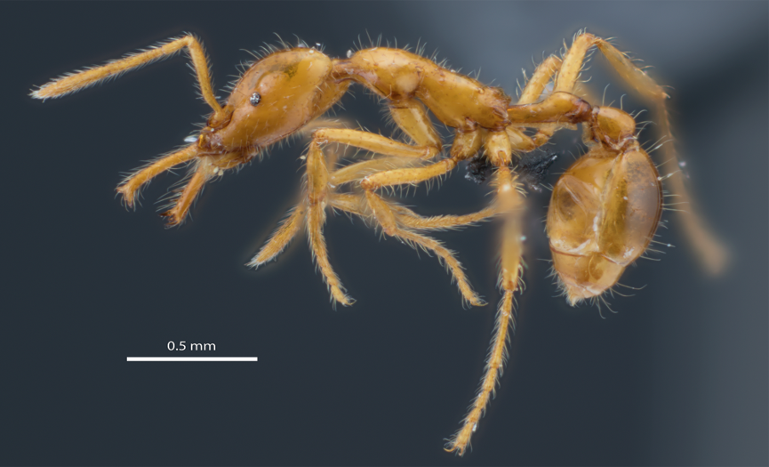

Who’s who?
Dasymutilla occidentalis
Euspinolia militaris
Strumigenys ayersthey

Slide 12
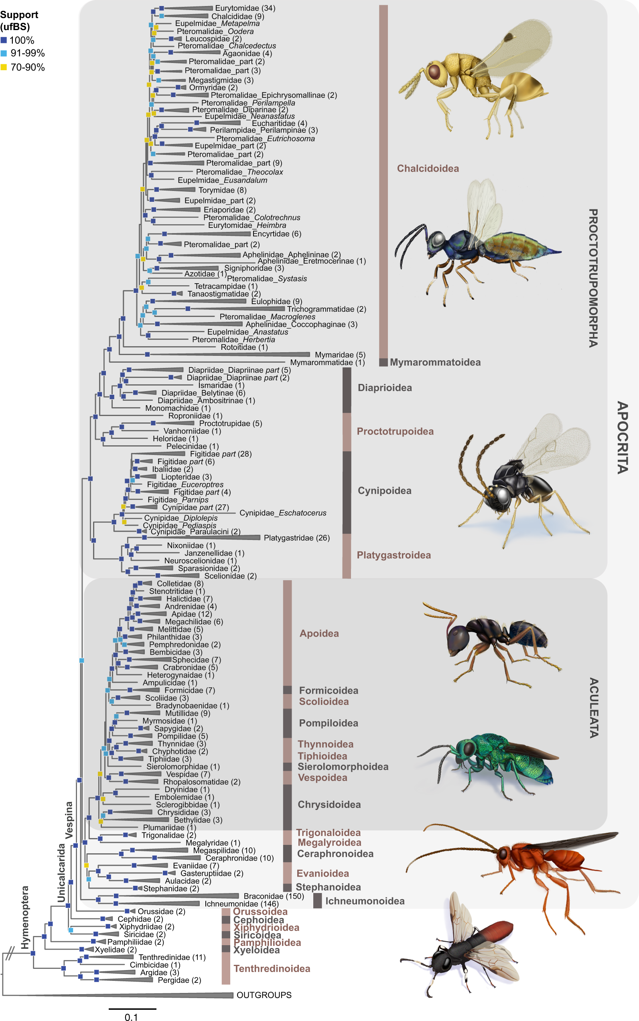

How do we know it’s an ant?
Ideas
Head
Alitrunk
Petiole
Gaster
Order?
Hymenoptera
Family?
Formicidae
Blaimer, B.B., Santos, B.F., Cruaud, A. et al. Key innovations and the diversification of Hymenoptera. Nat Commun 14, 1212 (2023). https://doi.org/10.1038/s41467-023-36868-4
Notes:
Blaimer, B.B., Santos, B.F., Cruaud, A. et al. Key innovations and the diversification of Hymenoptera. Nat Commun 14, 1212 (2023). https://doi.org/10.1038/s41467-023-36868-4

Slide 13
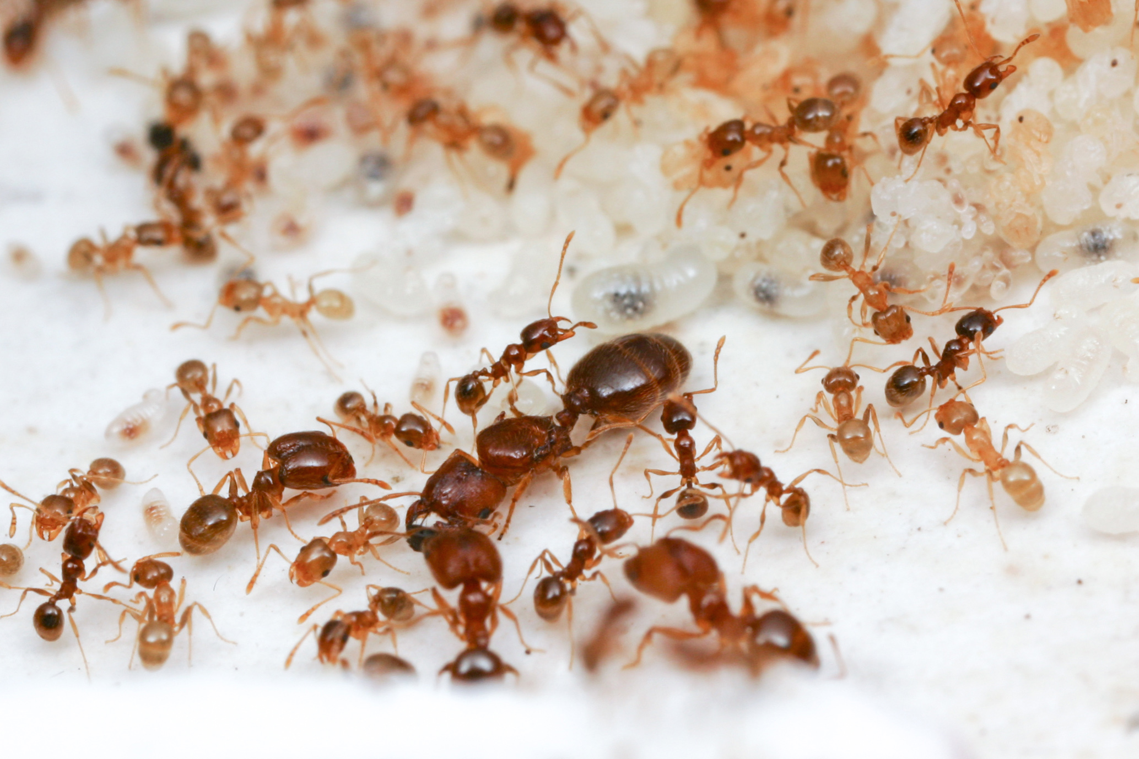
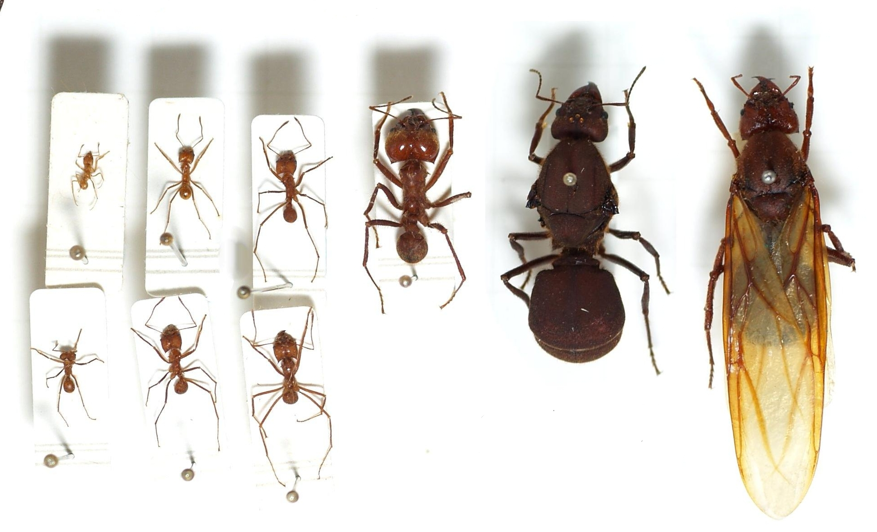
Eusociality: roomies forever
Alexander Wild (public domain). Pheidole californica
https://commons.wikimedia.org/wiki/File:Atta.cephalotes.gamut.selection.jpg
Notes:
https://commons.wikimedia.org/wiki/File:Atta.cephalotes.gamut.selection.jpg

Slide 14
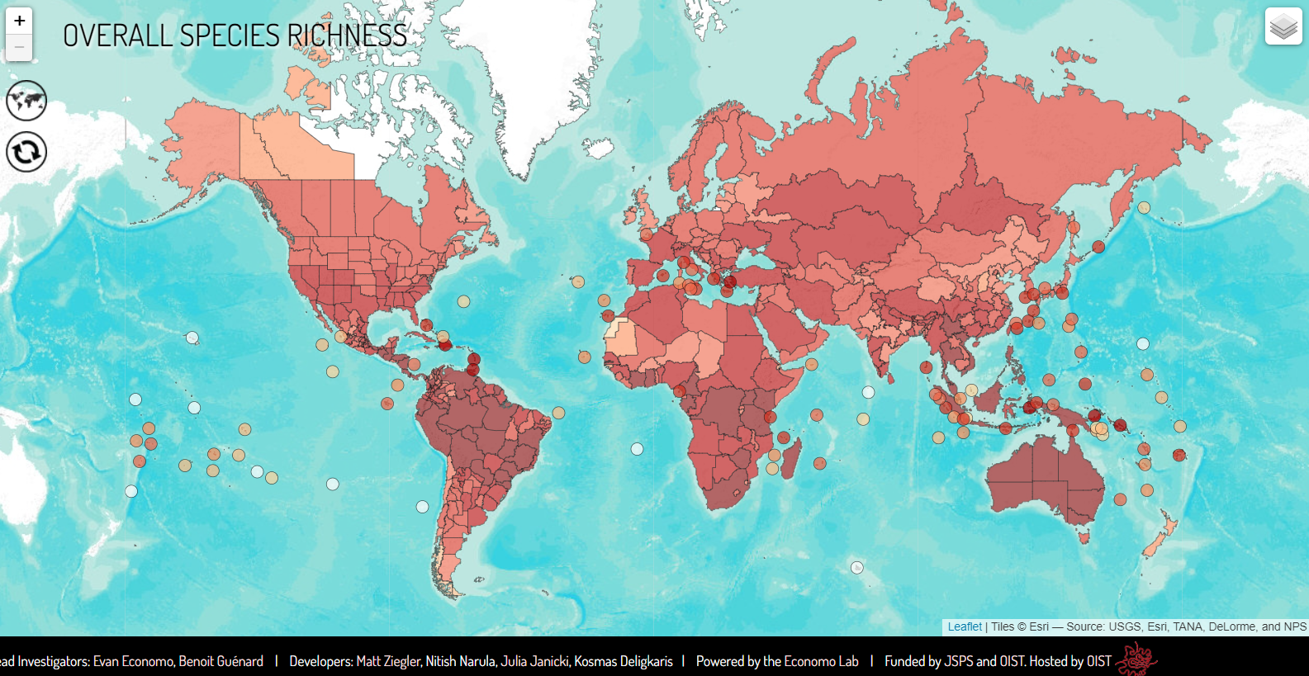
Ant distribution

Slide 15
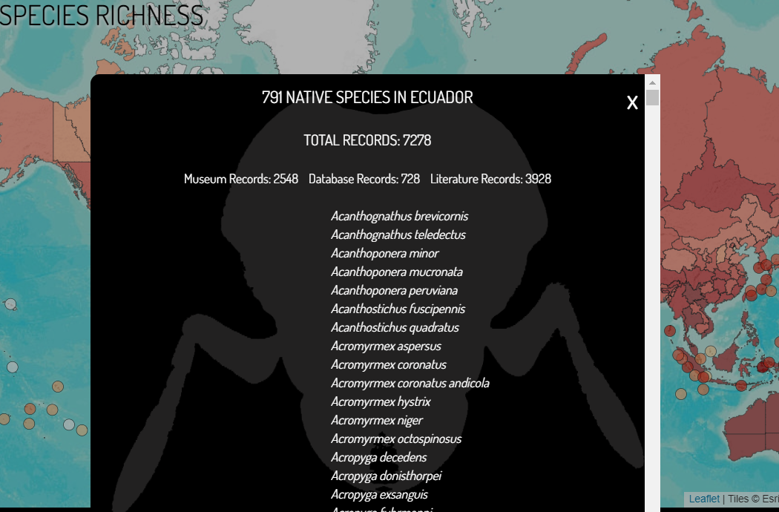
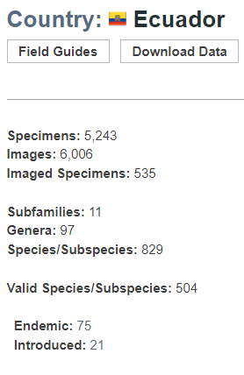
Ants in Ecuador

Slide 16
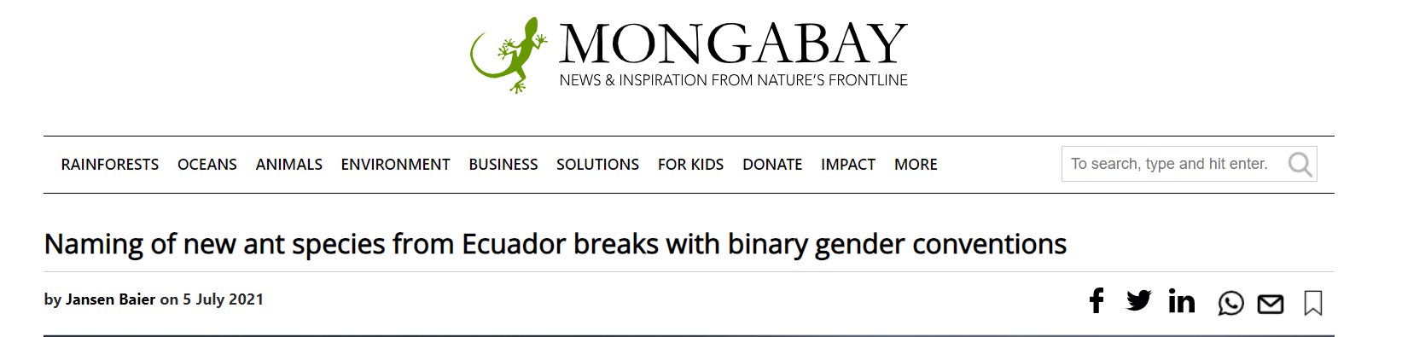
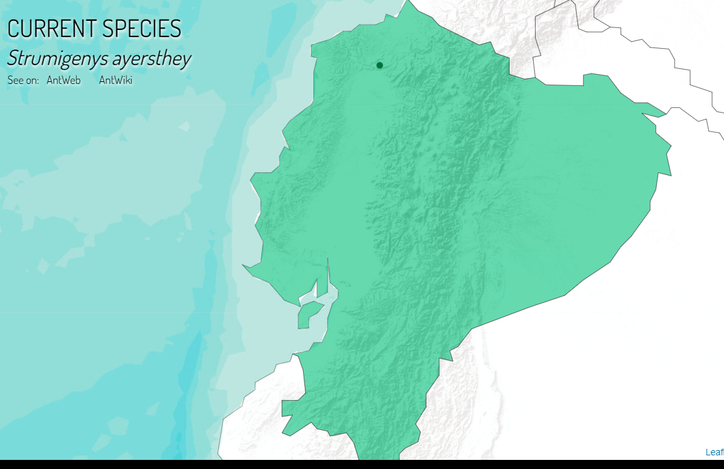
Ants in Ecuador
Many species to discover
Notes:
Reserva Río Canandé in Ecuador (Esmeraldas Province) on 2 May 2018. The reserve belongs to the Chocó-Darién bioregion

Slide 17
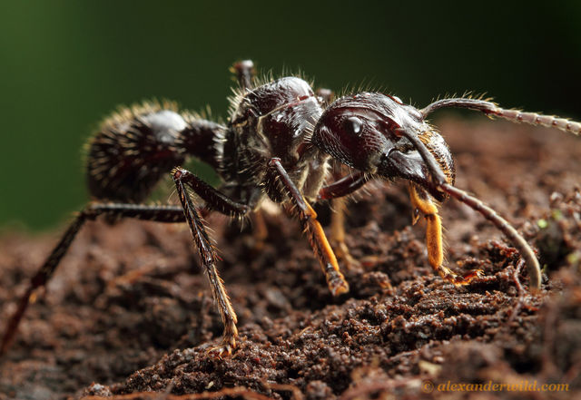
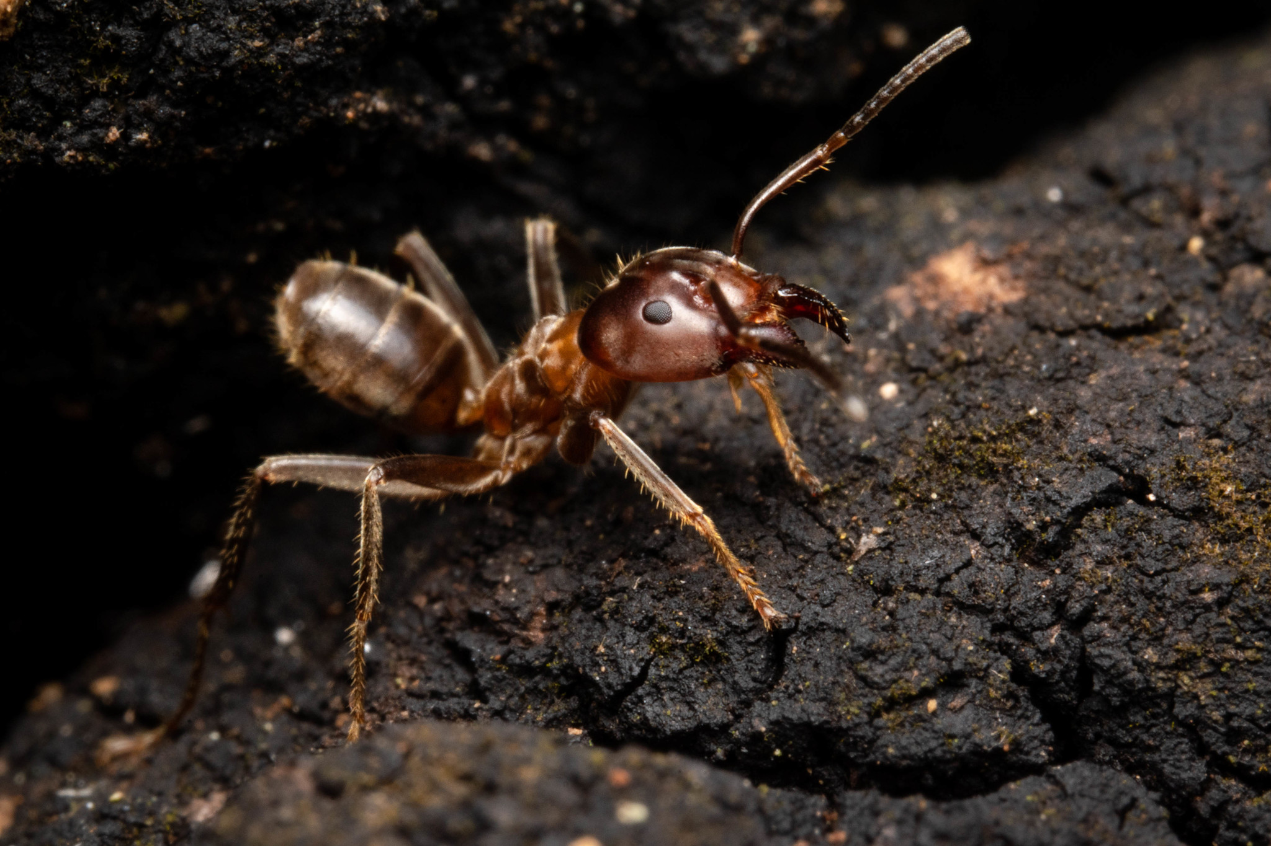
Ants ins Ecuador
Paraponera clavata (bullet ant)
Azteca spp. (cecropia ant)
http://www.inaturalist.org/observations/48272196

Slide 18
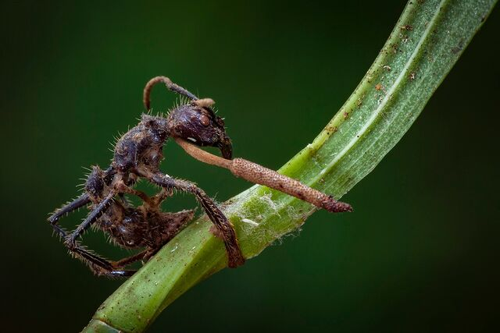
Ants ins Ecuador
Paraponera clavata
Azteca spp.
Ophiocordyceps. Photo by Piotr Naskrecki.
http://www.inaturalist.org/observations/48272196

Slide 19
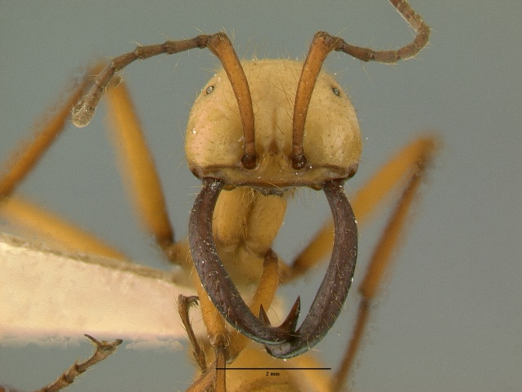
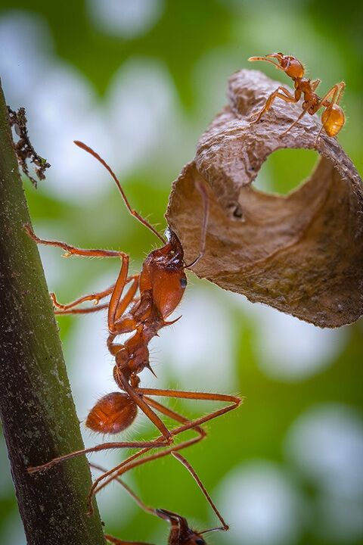
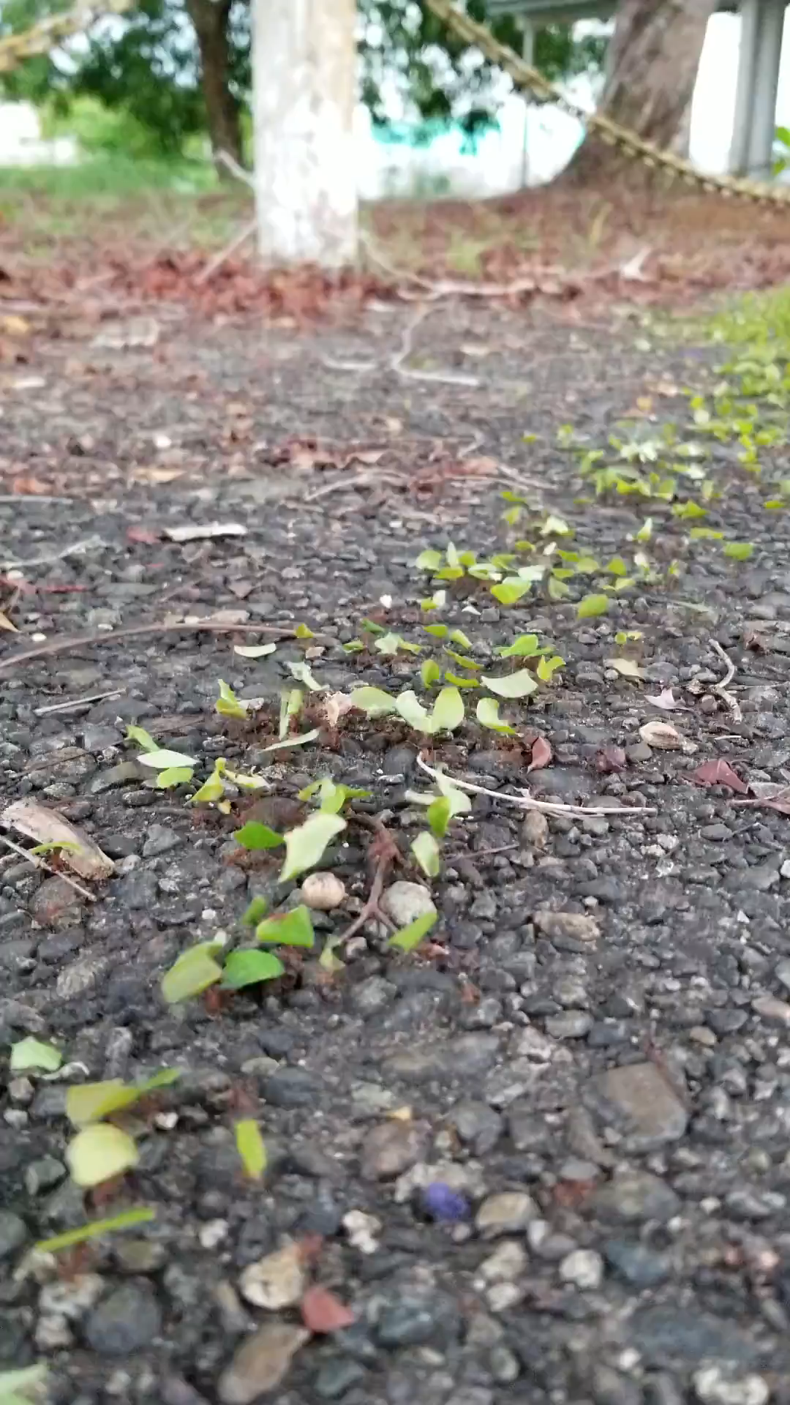
Ants in Ecuador
Eciton burchelli (army ants)
Atta cephalotes (leaf-cutter ants)
https://antwiki.org/wiki/File:Eciton-hamatumSF1.6.jpg
Photo by Piotr Naskrecki.
Bolívar Aponte Rolón

Slide 20
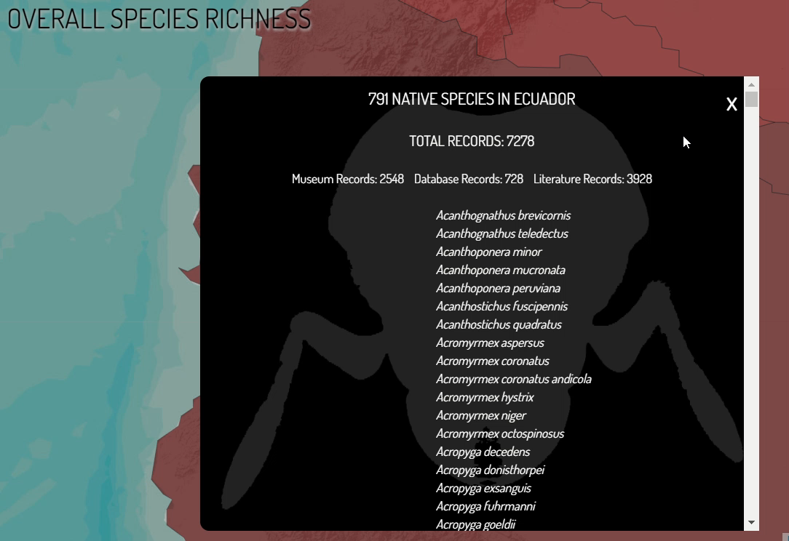
… and many more

Slide 21

Human impacts on the environment
https://www.caltech.edu/about/news/the-human-impact-on-the-environment

Slide 22
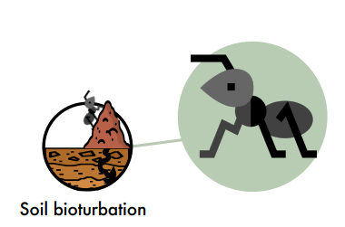
How can ants help us understand…
Ecosystem processes
Impacts on the environment
Ecological interactions
Biodiversity

Slide 23
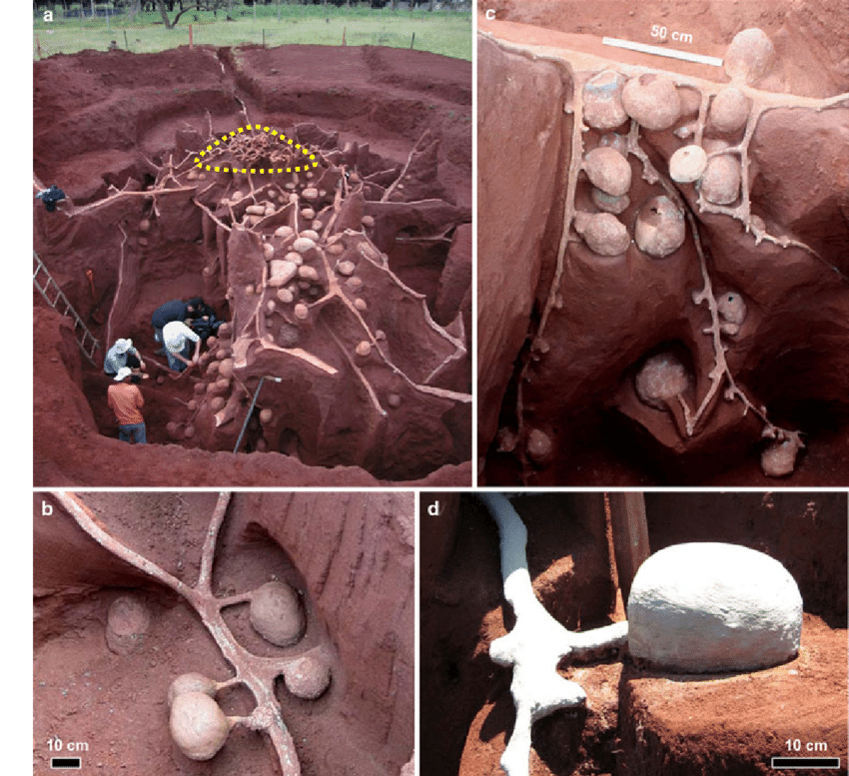
Ants and Ecosystem Processes
Soil bioturbation
https://www.researchgate.net/figure/Cement-casts-of-Atta-leavigata-nests-a-Overview-of-the-excavation-of-a-large-nest-The_fig5_257320036 [accessed 12 Jul, 2023]
Notes:
Jitte Groothuis (Jittebug Photography & Creations)

Slide 24
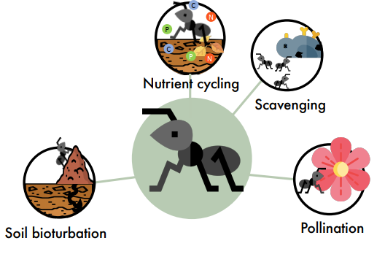
Ants and Ecosystem Processes
Biological pest control (service)
Pollination (to an extent)
Nutrient cycling

Slide 25
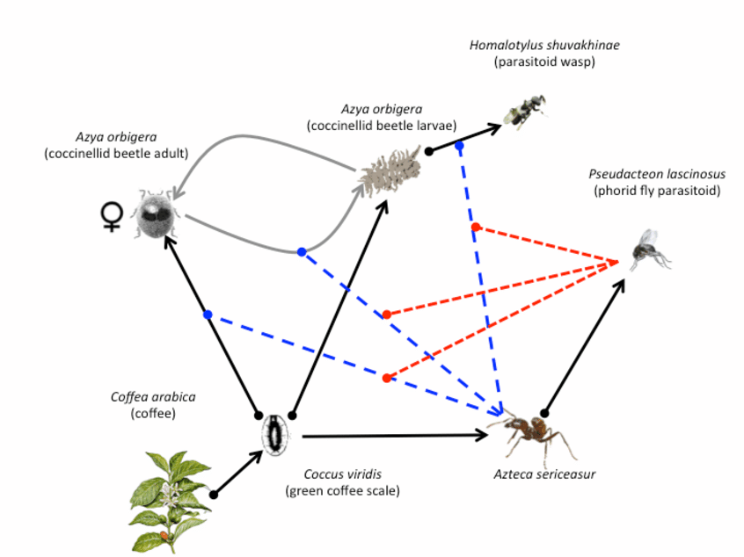
Ants and Ecosystem Processes
Biological pest control (service)
Hsieh, Hsun-Yi. (2015).

Slide 26
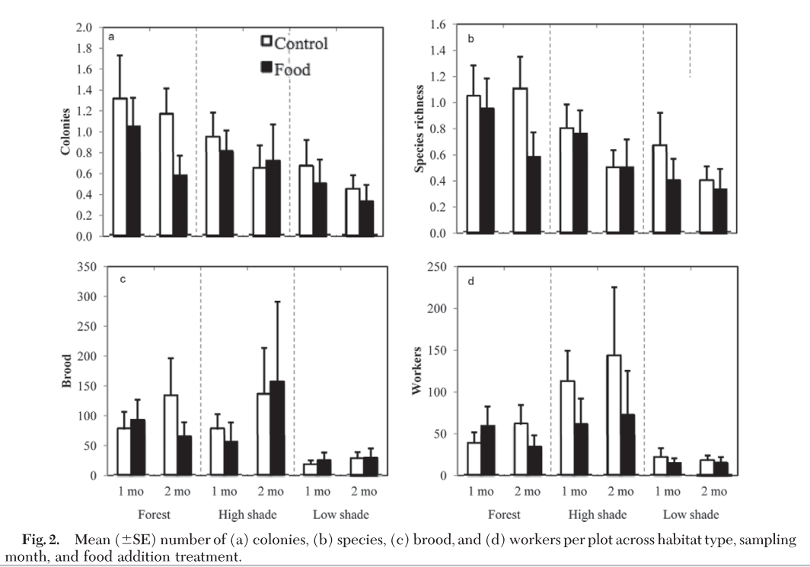
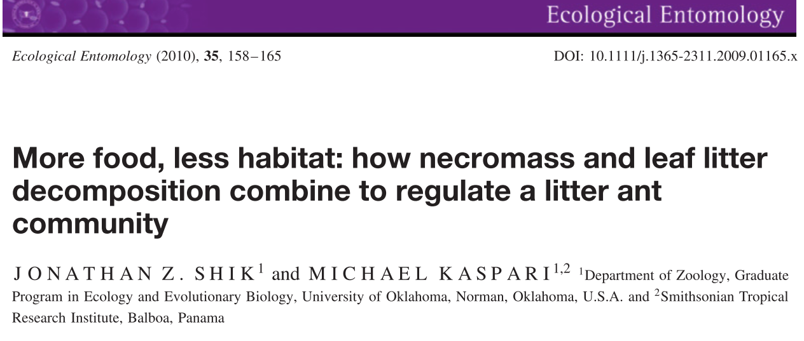
Ants and Ecosystem Processes
Nutrient cycling
Notes:
Murnen et al (2013) examined changes in numbers of ant species, colonies, workers, brood, colony growth rate, and ant species composition. Habitat type strongly affected ant communities, influencing ant species richness, numbers of colonies and workers, and ant species composition. However, food addition and nest addition did not affect these community characteristics. Colony growth rate did not differ with food addition but was greater in forest and low-shade coffee compared with high-shade coffee. Habitat differences in colony growth may be because of presence of an aggressive species (Wasmannia auropunctata Roger) in high-shade coffee plots or naturally low arthropod densities during a time when ant colonization was low. Thus, in coffee landscapes, habitat type impacts litter nesting ant community structure, composition, and colony growth rate; however, food and nest addition had small impacts.

Slide 27
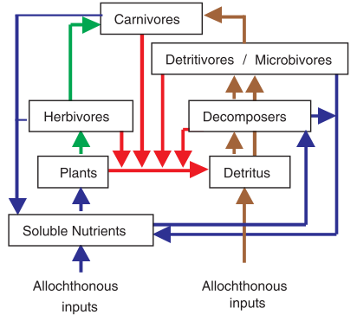
Ants and Ecosystem Processes
Nutrient cycling
Murnen et al (2013)
Moore et al (2004)
Notes:
Murnen et al (2013) examined changes in numbers of ant species, colonies, workers, brood, colony growth rate, and ant species composition. Habitat type strongly affected ant communities, influencing ant species richness, numbers of colonies and workers, and ant species composition. However, food addition and nest addition did not affect these community characteristics. Colony growth rate did not differ with food addition but was greater in forest and low-shade coffee compared with high-shade coffee. Habitat differences in colony growth may be because of presence of an aggressive species (Wasmannia auropunctata Roger) in high-shade coffee plots or naturally low arthropod densities during a time when ant colonization was low. Thus, in coffee landscapes, habitat type impacts litter nesting ant community structure, composition, and colony growth rate; however, food and nest addition had small impacts.

Slide 28
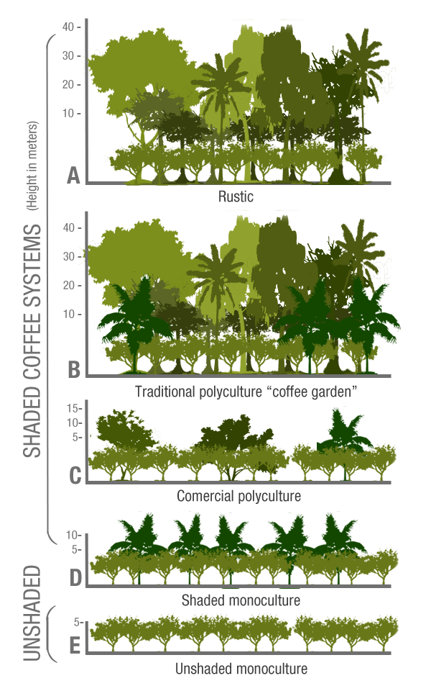
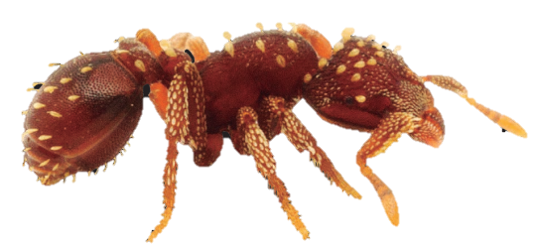
Ants and Ecosystem Processes
Coffee agroecosystems (case study)
Intensified agricultural plantations (sun-coffee) that result in low-biodiversity levels (Armbrecht et al., 2005; Perfecto et al., 1996).
Low-management (shade-grown) styles promote high levels of biodiversity (Philpott et al., 2008)
Moguel & Toledo (1999)
Notes:
Coffee agroecosystems range from low-management (shade-grown) styles that promote high levels of biodiversity (Philpott et al., 2008a) to intensified agricultural plantations (sun-coffee) that result in low-biodiversity levels (Armbrecht et al., 2005; Perfecto et al., 1996).
Scientific ecological literature in the last two decades has shown that shade trees play an important role in coffee agroecosystems, by providing shade they maintain soil moisture, control weeds and even alleviate pest breakouts (Morris and Perfecto, 2016; Soto-Pinto et al., 2002), they are also a good source of fuelwood and construction material (García-Barrios et al., 2009; Peeters et al., 2003; Valencia et al., 2014b). Tree species composition varies widely and it is highly dependent on the farmer’s preference and management practice (Valencia et al., 2014c).
Shade grown coffee hence, achieves both a high vale product and meets conservation goals by sustaining …MOVE ON TO NEXT SLIDE.

Slide 29
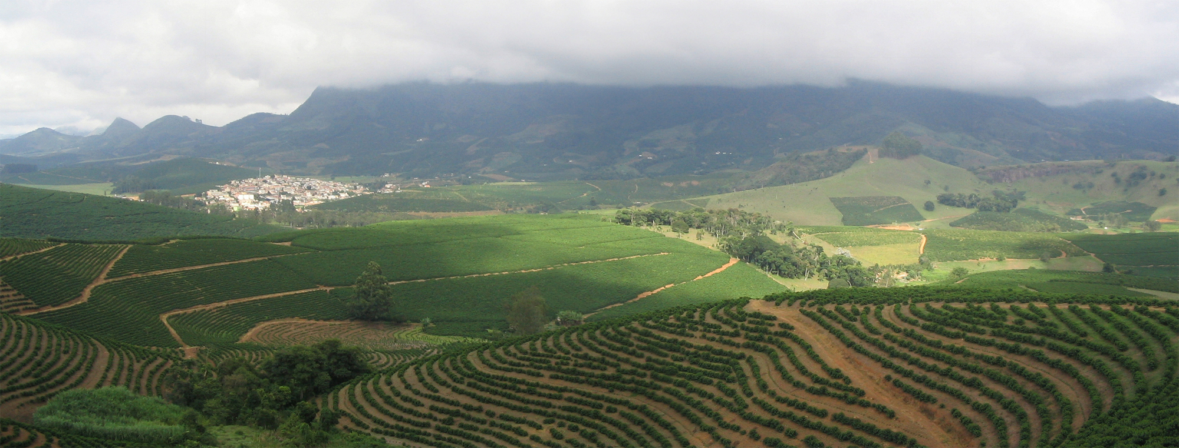
Coffee Plantation in São João do Manhuaçu City - Minas Gerais State – Brazil (2004)
Notes:
Here we have a sun coffee plantation in the state of Mina Gerais in Brazil. To achieve this a great large amount of natural habitat had to be taken apart.
While it is aesthetically pleasing, you can imagine that a plantation like this can sustain far less biological interaction than this other part.
Point at the plantation an then at the mountains.

Slide 30
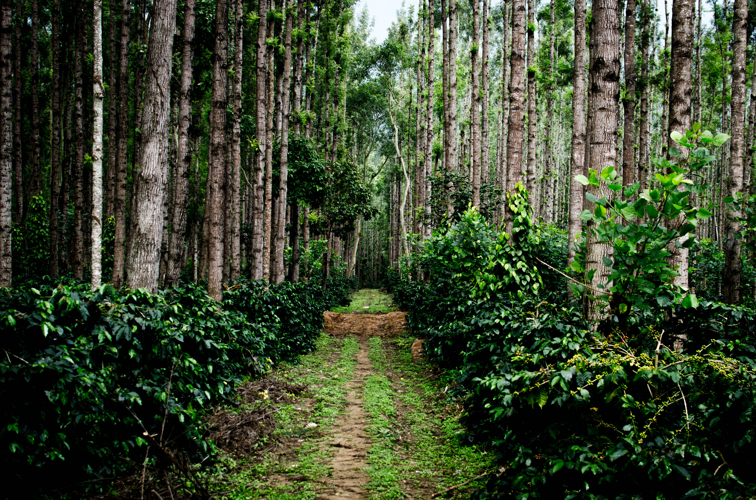
Coffee Plantation in Chikmagalur, India (2012)
Notes:
Coffee plantation in India.
It has a more complex structure. Mainly two levels: coffee plant ant shade tree. They are two monocultures: coffee plant and shade tree. While complecity increases it still works/looks very much like a managed system.

Slide 31
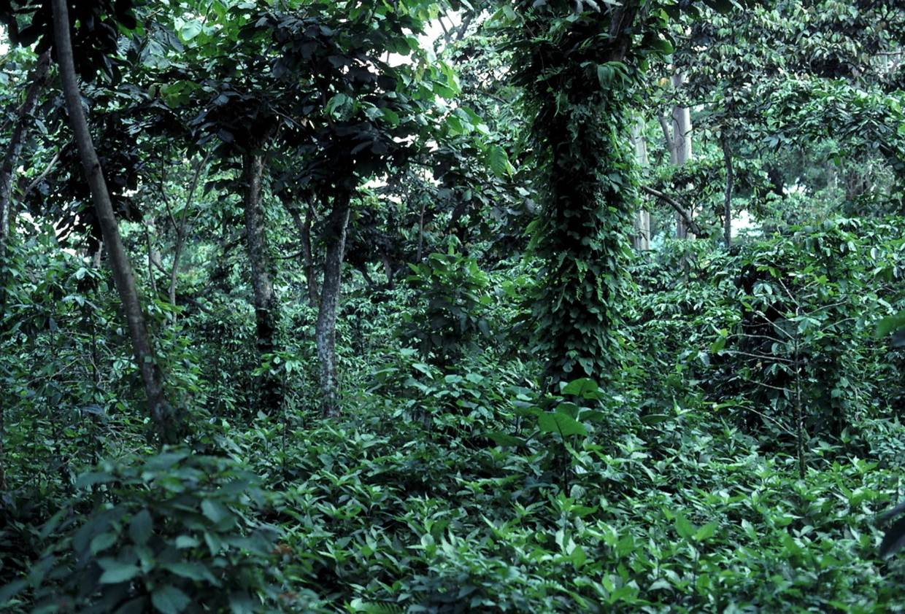
Notes:
This resembles more primary forest. Where you can barely distinguish the coffe plants from other plants and shade trees. Contains a large amount of shade tree species etc.

Slide 32
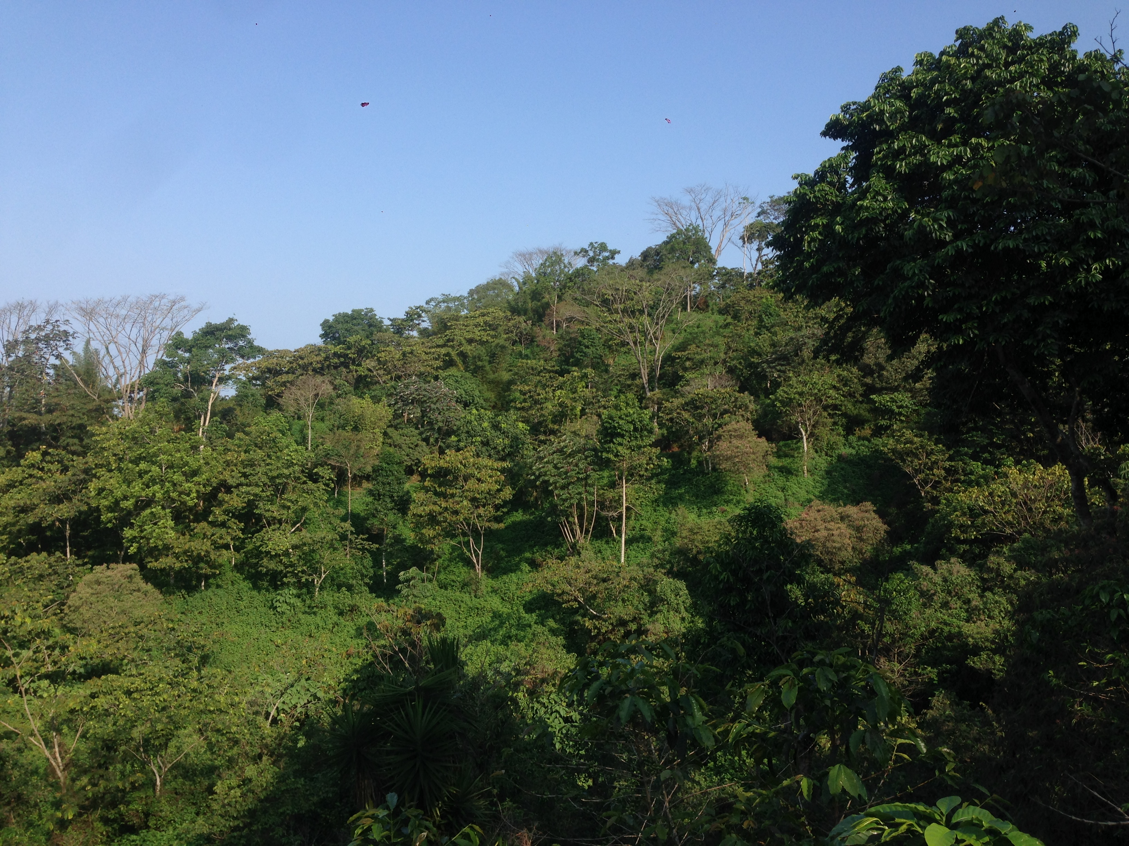
Finca Irland, Soconusco, Chiapas, Mexico

Slide 33
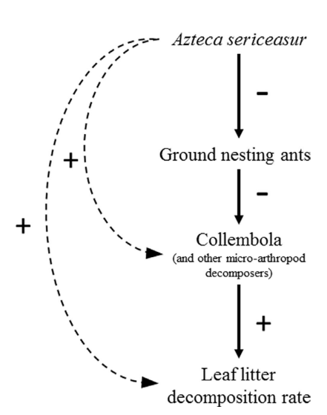
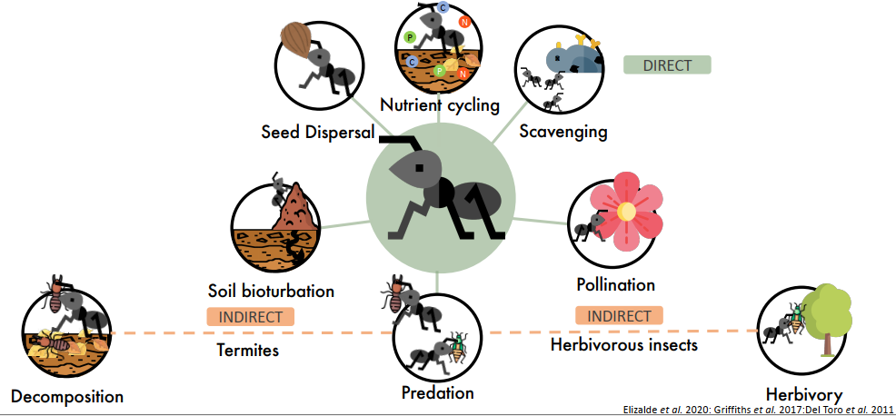
Ants in Coffee Agroecosystems
Decomposition
Schmitt et al. 2019.

Slide 34
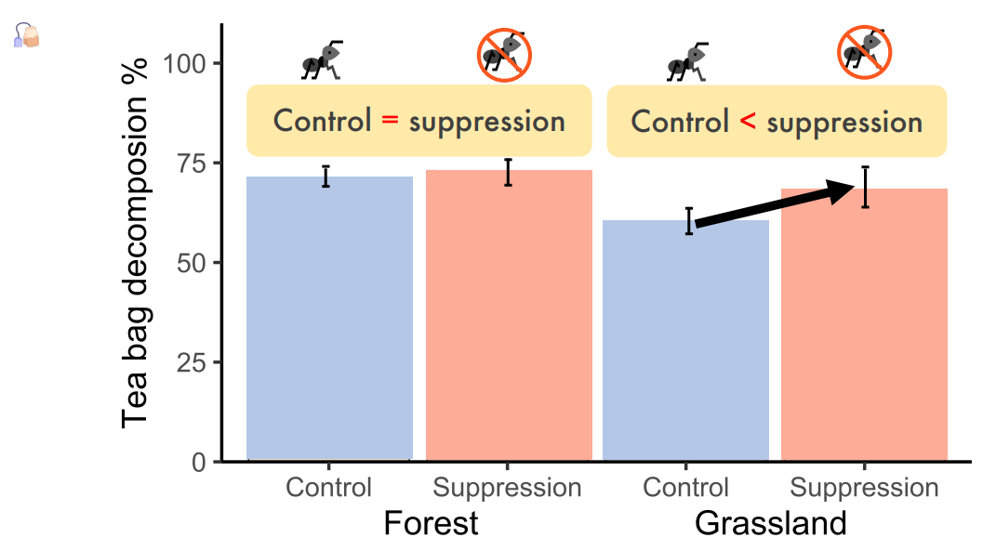
Ants and Decomposition
Data from Tiago Fernandes, PhD.

Slide 35
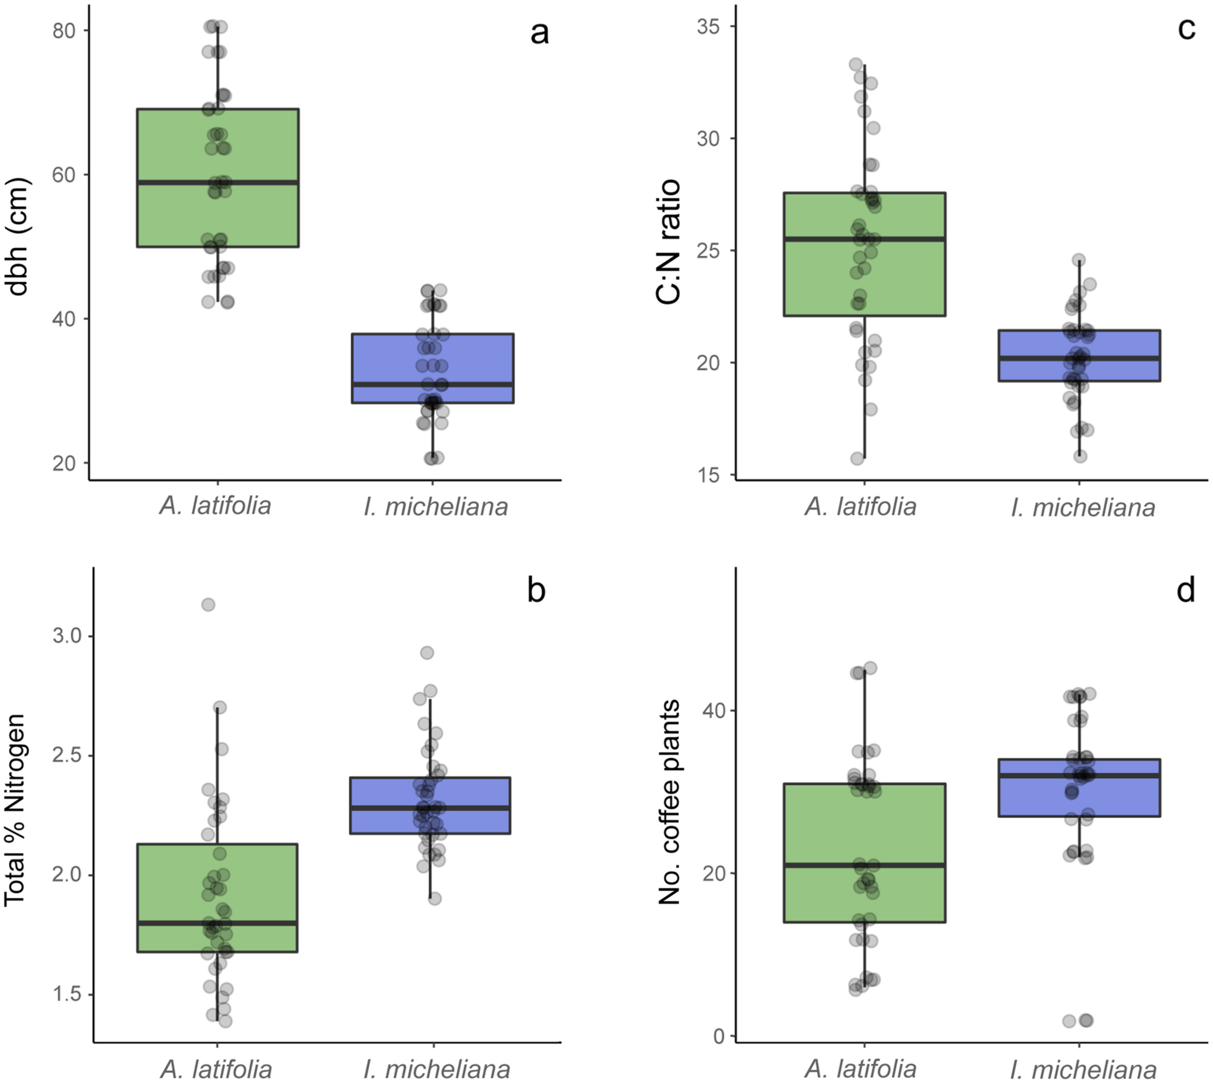

Ants in Coffee Agroecosystems
Nutrient availability and Ants
Distance to Edge and Ants
Aponte Rolón & Perfecto 2023
Aponte Rolón & Perfecto 2023.

Slide 36

Ants in Coffee Agroecosystems
Predation and Herbivory

Slide 37


Ants in Coffee Agroecosystems
Predation/trait-mediated interactions
Perfecto et al. 2021. https://doi.org/10.1016/j.agee.2020.107104

Slide 38

Ants in Tropical systems
Herbivory
By predating on other insects, ants can reduce herbivory.
Data from Tiago Fernandes, PhD.

Slide 39


Ants in Tropical systems
Farming ants?
Atta & Acromyrmex (Attini)
Atta sexdens
Atta colombica
Christian R. Linder (1999).

Slide 40

Ants and Leaf Traits
Plant have multiple defenses to counter ants.
Physcial, chemical and ecological traits can influence potential impacts of ant herbivory.
Aponte Rolón, unpublished (2023).

Slide 41
Take home messages
Ants influence multiple ecosystem processes.
Understanding ant ecology (fine scale) provides insight into large scale ecosystems process.
Ants are complex and fun, just like us!

